Slide 1
Lesson objective
Title: Negative numbers
Aim:
Be able to multiply and divide using negative numbers
Plan:
Daily review
Skills practice

Slide 2
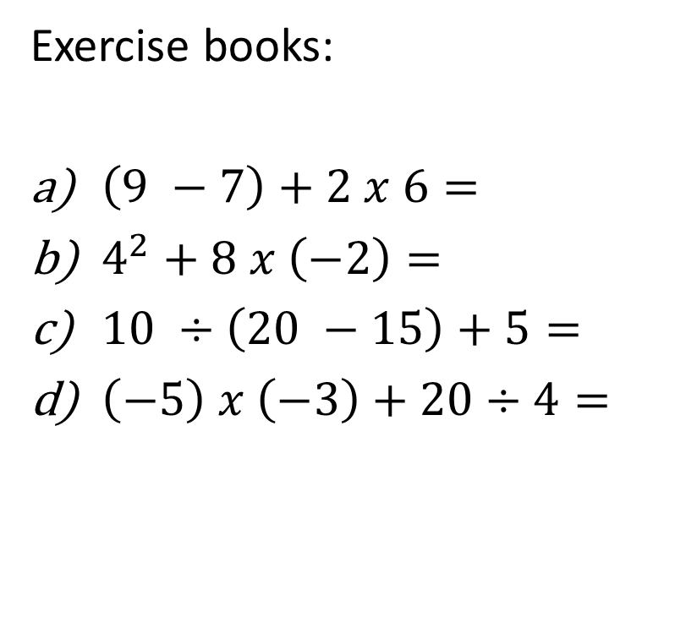
Daily review
Exercise books:
$\left(9 −7\right)+2 x 6=$
$4^{2}+8 x \left(−2\right)=$
$10 ÷\left(20 −15\right)+5=$
$\left(−5\right) x \left(−3\right)+20÷4=$
14
0
7
20

Slide 3
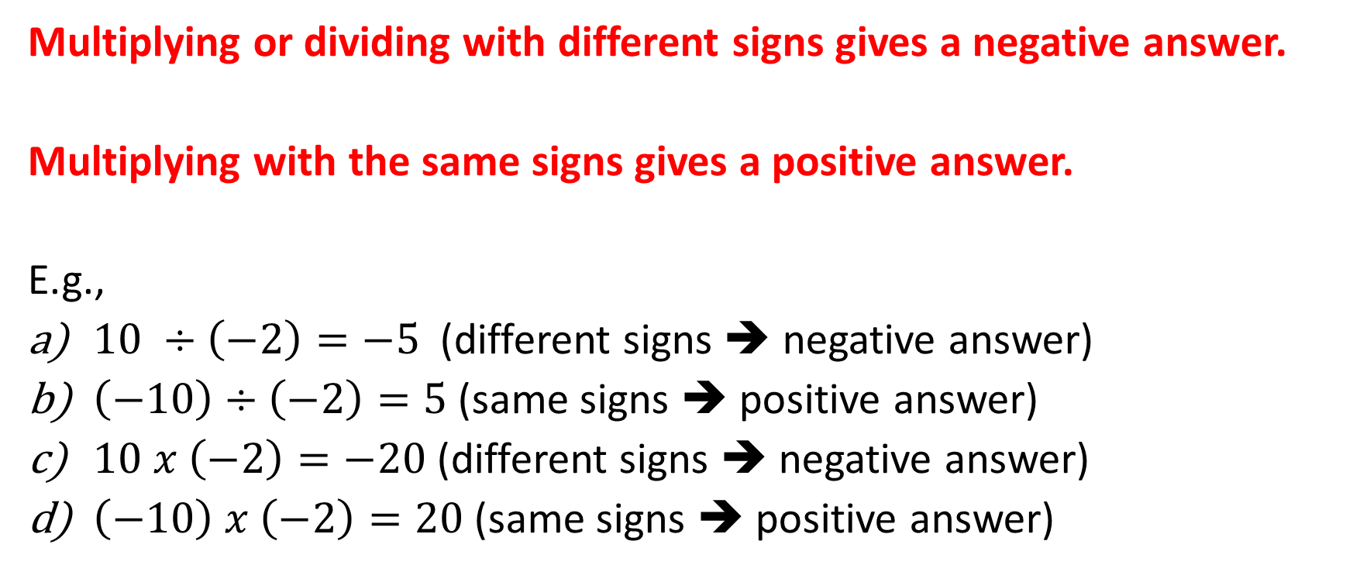
Multiplying and division with negatives
Multiplying or dividing with different signs gives a negative answer.
Multiplying with the same signs gives a positive answer.
E.g.,
$10 ÷\left(−2\right)=−5$ (different signs ➔ negative answer)
$\left(−10\right)÷\left(−2\right)=5$(same signs ➔ positive answer)
$10 x \left(−2\right)=−20$(different signs ➔ negative answer)
$\left(−10\right) x \left(−2\right)=20$(same signs ➔ positive answer)

Slide 4

Individual practice
Use the lattice method for multiplication and use the standard algorithm for division.
Division example: $435 ÷4=$
Start: “what happens when you swallow a doorknob?”
108.75
4
435.00

